Slide 1

Specialisation project:
Scanning Antivirus

Slide 2
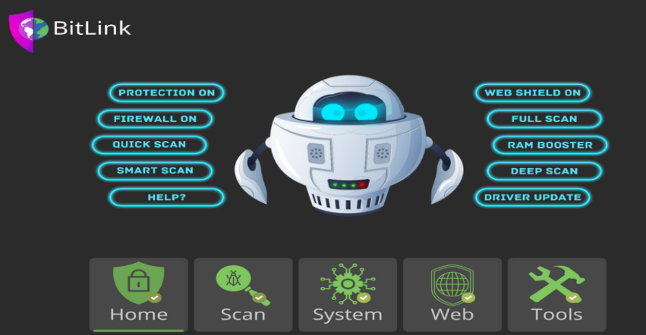
Introduction
Welcome to the exploration of Effective Antivirus Strategies for strengthening cybersecurity.
This presentation will delve into the key principles and best practices for safeguarding digital assets against evolving threats.

Slide 3

Understanding Antivirus Software
Antivirus software is a critical component in cybersecurity defense.
It is designed to detect, prevent, and remove malicious software, providing a crucial layer of protection for digital environments.

Slide 4
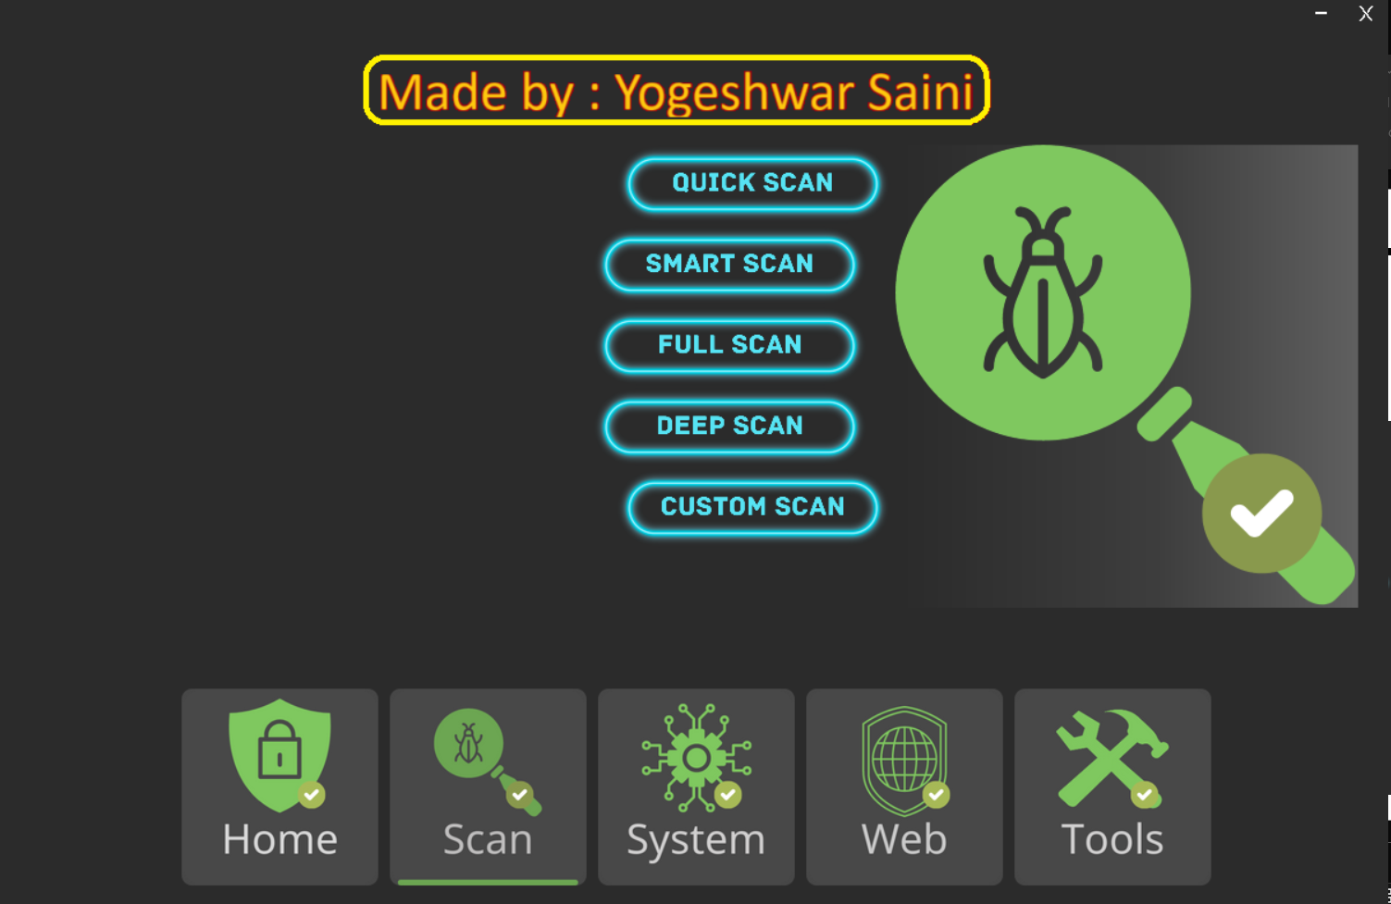
Real-time scanning and behavioral analysis are essential for identifying and neutralizing emerging threats. These mechanisms ensure proactive defense against malicious activities.
Real-time Protection Mechanisms

Slide 5

Optimizing Antivirus Conﬁgurations
Customizing antivirus settings and regular updates are imperative to maintain the efﬁciancy of the security solution. This ensures comprehensive coverage and adaptability to new threats.

Slide 6

Integrating antivirus solutions with network security infrastructure enhances the overall defense posture. This approach fortiﬁes perimeter protection and mitigates potential cyber intrusions.
Network Security Integration

Slide 7

Conclusion
At last we conclude that antivirus stand as a crucial safeguard In our digital landscape
it provide a vital layer of protection for both online and offline environment
It is more than just a security tool ,it play a unique and indespensible role role in keeping our digital journey secure and worry-free.

Slide 8
Thanks!
Do you have any questions?
Yogeshwar Saini
(E23MCAG0025)
Lakshit Joshi

